Slide 1

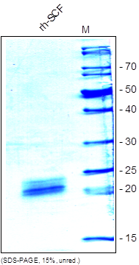
Reliatech GmbH
Recombinant human SCF
(Cat# 400-013 / 400-0104)
Fig. 1: SDS-PAGE analysis of recombinant human SCF produced in insect cells. Sample was loaded in 15% SDS-polyacrylamide gel under reducing conditions and stained with Coomassie blue.
http://www.reliatech.de / orders@reliatech.de

